Slide 1
Public Health Theory & Tools for Impactful Program Evaluation
New Mexico Evaluators Association October 1, 2019
Terry Schleder, MPH
Terry@PivotEval.com
Notes:
Terry Schleder, MPH Terry@PivotEval.com

Slide 2
What is Health?
And why does the definition matter?
Notes:
You may think there’s a unified agreement on this, and you would be wrong…

Slide 3
What is Health? How is it Promoted?
Dictionary: “the state of being free from illness or injury.”
WHO: “is a state of complete physical, mental and social well-being and not merely the absence of disease or infirmity.”
The Ottawa Charter on Health Promotion (1986)
Health promotion is the process of enabling people to increase control over their health and its determinants, and thereby improve their health.
Notes:
In PubHealth, we define Health broadly and different than the dictionary does. Intentionally.
Because it’s more than the absence of disease, and there are many and varied prerequisites to attaining and promoting health.

Slide 4
Health Promotion – Prerequisites for Health
The fundamental conditions and resources for health are:
peace,
shelter,
education,
food,
income,
a stable eco-system,
sustainable resources,
social justice, and equity.
Improvement in health requires a secure foundation in these basic prerequisites.
Notes:
From The Ottawa Charter for Health Promotion
First International Conference on Health Promotion, Ottawa, 21 November 1986
https://www.who.int/healthpromotion/conferences/previous/ottawa/en/
Where have you/your clients experienced a state of health, and what made it so?

Slide 5
What is Evaluation?
And where is it done?

Slide 6
What is Evaluation?
“Examination of the worth, merit, or significance of an object.”
“Program evaluation is a systematic method for collecting, analyzing, and using information to answer questions about projects, policies and programs, particularly about their effectiveness and efficiency. ... Program evaluations can involve both quantitative and qualitative methods of social research.”
Strategy & Method
Notes:
Scriven M. Minimalist theory of evaluation: The least theory that practice requires. American Journal of Evaluation 1998;19:57-70
https://en.wikipedia.org/wiki/Program_evaluation

Slide 7
Evaluation’s Purposes
Assessment of the need for the program
Assessment of program design and logic/theory
Assessment of how the program is being implemented (i.e., is it being implemented according to plan? Are the program's processes maximizing possible outcomes?)
Assessment of the program's outcome or impact (i.e., what it has actually achieved)
Assessment of the program's cost and efficiency
Notes:
Rossi, Lipsey and Freeman (2004) Evaluation : A Systematic Approach, Sage Pub
Https://www.slideshare.net/israelvc12/evaluation-a-systematic-approachrossilipseyfreeman
Note the RBA logic embedded in these purposes, and the room for qual and quant, formative and summative methods.
But what exactly are programs?

Slide 8
What are Programs?
Per the CDC:
Direct service interventions (e.g., a program that offers free breakfasts to improve nutrition for grade school children)
Community mobilization efforts (e.g., an effort to organize a boycott of California grapes to improve the economic well-being of farm workers)
Research initiatives (e.g., an effort to find out whether disparities in health outcomes based on race can be reduced)
Advocacy work (e.g., a campaign to influence the state legislature to pass legislation regarding tobacco control)
Training programs (e.g., a job training program to reduce unemployment in urban neighborhoods)
Notes:
CDC’s Introduction to Program Evaluation for Public Health Programs
https://www.cdc.gov/eval/guide/introduction/index.htm

Slide 9
What is Public Health?
Says who, and where did it come from?

Slide 10
“Public health promotes and protects the health of people and the communities where they live, learn, work and play.”
- American Public Health Association (APHA)
Notes:
PH is more of a collection of strategies across fields and disciplines, than any one thing. Medical, social services, legal, crim justice.
If PubHealth means so much, and in so many places, where might programs and their evaluators focus the lens when placing program strategies in a public health context?

Slide 11
What Makes Communities Healthy?
(It’s much more than clinical care.)
“A combination of multiple modifiable factors, from clean air and water to stable and affordable housing, need to be considered to ensure community health for all.”
Notes:
RW’s County Health Rankings Model: https://www.countyhealthrankings.org/explore-health-rankings/measures-data-sources/county-health-rankings-model/health-factors

Slide 12
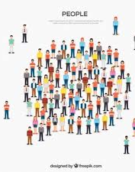
Epidemiology
The Science of Public and Population Health
Dictionary: “the branch of medicine which deals with the incidence, distribution, and possible control of diseases and other factors relating to health.”
The CDC: “Epidemiology is the study of the distribution and determinants of health-related states or events in specified populations and the application of this study to control health problems.”
Pops vs People
Mostly quantitative, but…
Notes:
The science of PubHealth is foundational to our strategies. Populations matter more than individuals.
In PubHealth, we define Epi more broadly and apply it to all the aspects of health and health promotion.

Slide 13
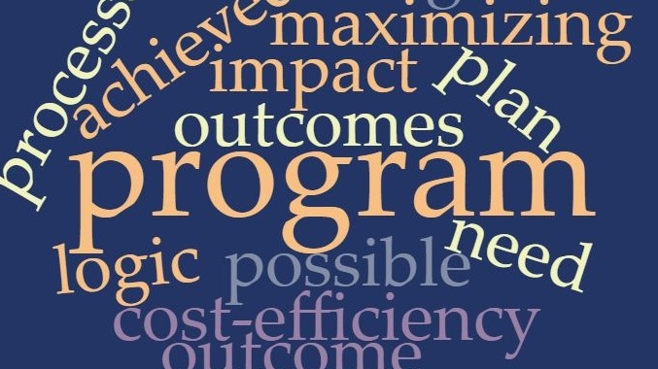
Notes:
What about Wordclouds? They’re proportional – the Epidemiology of words can be a useful eval tool.
Anyone ever used these in their evaluation or community work? World clouds aren’t Epi but they have visuals in common…

Slide 14
John Snow: Father of Modern Epidemiology
“How often does a map change the world?”
Notes:
Speaking of visualizing data, the history of Epidemiology begins with a map…

Slide 15
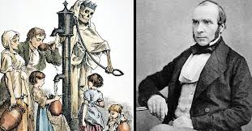
Notes:
Meet Dr. John Snow and his Broad Street Pump

Slide 16
Dr. John Snow’s Broad Street Pump …the first DataViz?
London, England - 1854
Life Was Hard
Pre “Germ Theory”
Mapped Cases & Deaths with Bars
Dr. Snow Finds Source of Contaminated Water
Ends Cholera Outbreak

Slide 17
PubHealth & Eval: Overlaps, Compliments, Contrasts
Devils in the details

Slide 18
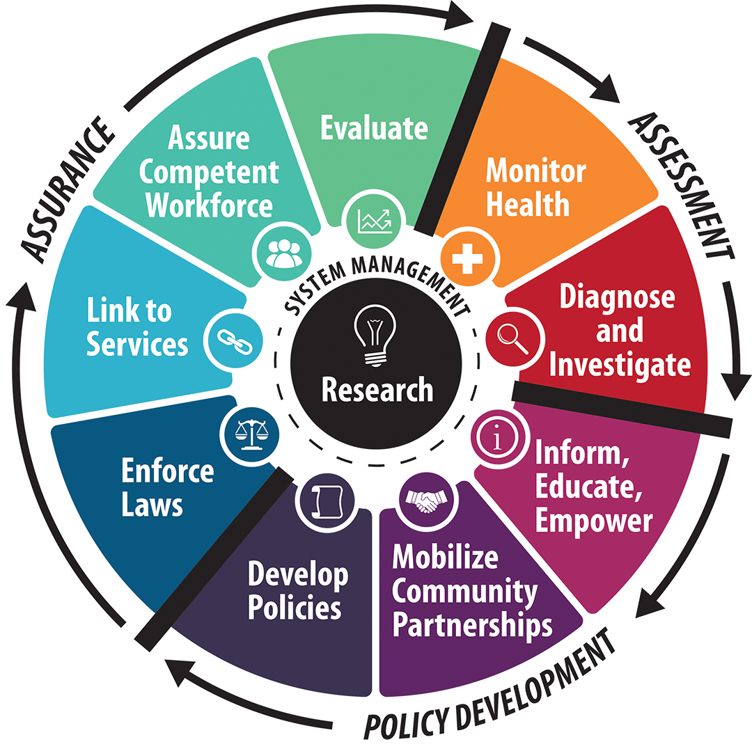
Public Health’s Core Functions
Assurance
Assessment
Policy Development
Notes:
What do we mean by these?
Why is eval in Assurance vs Assessment?

Slide 19
Evaluation: a Core Function of PubHealth
Engage
Describe
Focus
Gather Evidence
Justify Conclusions
Ensure Use & Lessons
Notes:
Per the CDC’s Framework for Program Evaluation in Public Health: https://www.cdc.gov/eval/guide/introduction/index.htm#Framework

Slide 20
Overlaps (or Not?) Between PH & Eval
Community vs Program Indicators
Science vs Advocacy
Community Context Adds Value
Where’s the “Impact”?
What is an “Impact”, and says who?
Impact vs Association: Who’s Right?
How does it matter?
What is “Evidence” & why?
Notes:
Questions about our fields’ (fields of fields, actually) overlaps help evaluators and program planners work with community and program leaders to apply findings.
Where do people/programs end and community begins? Who’s to say?

Slide 21
Some Public Health Tools
Concepts & Strategies Across Disciplines, Time, and Space

Slide 22
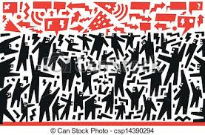
Community Based Participatory Research CBPR
What if Paolo Freire, Saul Alinsky, Vine Deloria, and Frida Khalo had a baby?
“applied social science and social activism” – Wallerstein & Duran
"collaborative approach that equitably involves all partners in research…with the aim of combining knowledge and action for social change to improve health and eliminate health disparities”. Not simply a set of research methods, CBPR fundamentally changes the relationship between researchers and researched.”
People + Power = Healthy Communities
Notes:
Please forgive me, Nina Wallerstein, for putting your life’s work and countless books in to one slide. Xo, Terry

Slide 23
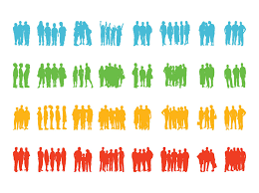
The Social Determinants of Health and Disease
Old knowledge about sanitation, hygiene, germs
New methods of assessing, associating, describing health and disease burdens
Association vs Causality and Unicorns
Health vs PubHealth
Notes:
What projects do you work on that relate to SDoH, and how?
Where do you find population–level data about SDoH?
How do you use SDoH knowledge in your evaluations?
What limits have you come across when using SDoH info?

Slide 24
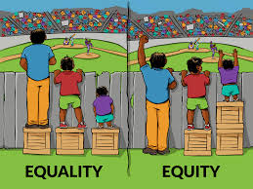
Health Equity
Because equality isn’t always healthy
Proportionality matters to healthy communities
Data trends reveal opportunities
Methods
CBPR – Community Based Participatory Research
Community Leaders as Experts
Notes:
graphic

Slide 25
PubHealth Surveillance Systems
NM IBIS – NM DOH Data Source
Public Data for the
Common Good
Disease Control
Program Planning
Community Assessment
Research on Program Impact
Notes:
https://ibis.health.state.nm.us/

Slide 26
PubHealth Open Data: NM CDC (Community Data Collaborative)
Interactive Maps tell stories with public health, education, economic and other data
Community Mappers
Program Planning
ArcGIS platform
Data Democratization for the Common Good

Slide 27
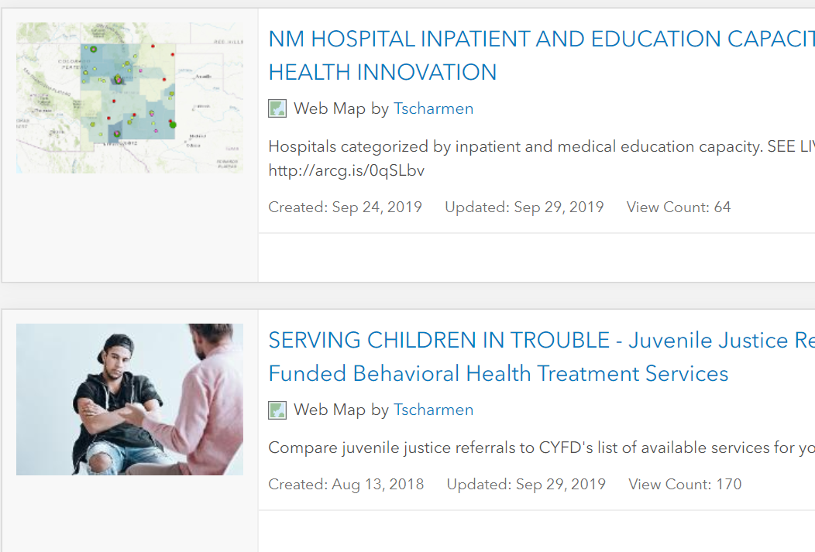
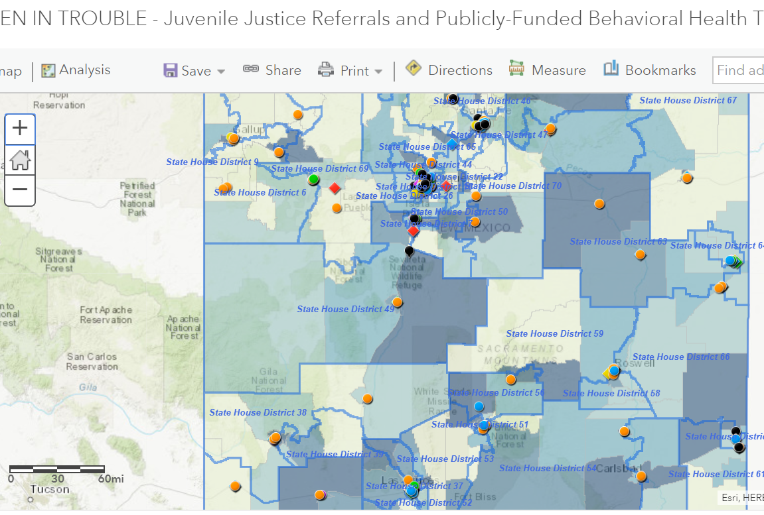
NM CDC - Interactive Maps for Research and Planning

Slide 28
Health Impact Assessment (HIA)
A form of Community Needs Assessment for Policy Change
Grounded in Community as Leaders and CBPR
“a process that helps evaluate the potential health effects of a plan, project, or policy before it is built or implemented. HIA brings potential positive and negative public health impacts and considerations to the decision-making process for plans, projects, and policies”
Screening, Scoping, Assessment, Recommendations, Reporting, M & E
Notes:
The CDC on HIA: https://www.cdc.gov/healthyplaces/hia.htm
NM Health Equity Project, our local HIA funder and TA site: http://nmhep.org/research/hia/

Slide 29
Notes:
NMHEP.org- housed in the NM Health Equity Project

Slide 30
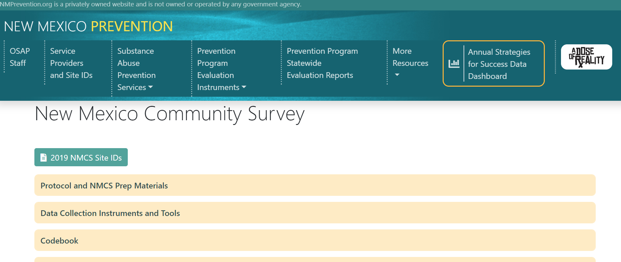
A Case Study: PIRE’s NM OSAP Evaluation – A Brief Overview
“Linking Evaluation, Data & Prevention Programming”
Notes:
Introduce Kim Zamarin

